Slide 1
Project Title
170896870
Duy Huu Nguyen
George Fazekas

Slide 2
Project Aims
What problem are you trying to solve for this project?
Artists tend to have deep thoughts while working on artworks.Nonetheless,this could leads self-isolation due to lack of socializing because of long hours of work.In addition, this is an act of rumination, which is agreed by psychologists and psychiatrists to be the cause of depression because not only do artists have to loop through an experience again and again due to deep thinking,they also might not be able to share to those experiences to anyone because of self-isolation
This project aims to aid artist in easing the looping cycle of thoughts due to rumination and creating a platform where artists can socialize with each other while still being able to work simultaneously.Because of this, the goal of the project to is to create a platform where artists can interact with each other through socializing and painting,the project can be a great source of inspiration and entertainment for artist as this can act as a meeting place for artist to come to paint and have conversation with each other.

Slide 3
Project Objectives
Design an application for sharing artworks
l Design a gallery system for displaying artworks that can be viewed by users(artists)
l Design a chatting platform for artists to come for chatting and painting
l Design canvas and brush systems with UI and functionality that artists are familiar with
l Research on similar products,evaluate their pros and cons
l Do literature review on work relate to Depression, socialization for artist
l Derive from the research the methods, algorithms and techniques need to be applied to and what can be improved on the project based on other similar projects
l Decide on what tool/languages/framework to use for implementation
l Decide which DBMS to use for implementation

Slide 4
Why is this a Engineering/Computing problem?
The project uses Engieering Design Process due to the following reasons:
It solving a problem
Requires research about the problem in terms of background and solutions
Requires requirements analyzing and derivation
Requires Development and Prototype of the solution using tools consits of: frameworks,IDE,knowledge of web protocols
Requires Testing and debugging of the application.

Slide 5
Literature Review Findings
How have others approached this, or a related, problem in the past?
This has always been a problem for artists for many years with examples from famous artists for example: Vincent Van Goth.However, dispite the existence of many social media platforms for sharing artwork, they tends to limit user to posting and texting without real time interaction such as: chatting or online hangout
Second problem is the the projects aims to allow user paint and chat at simutanously at the same time in real time and so far ,there is very few number of application that has this approach,such as : MagmaStudio.

Slide 6
Literature Review Findings
What lessons can be learned from what has been done before?
The developed application must have real time interaction and allows chatting and texting while painting to give the user the freedom in communication as well as essential tools needed for digital painting
The project must also allows for sharing of post so user can interact and give feedback on each other's works.

Slide 7
What is your proposed solution?
How will you solve the problem stated on the previous slides?
The project is a web application that allows user to create/join rooms with other users to communicate through voice/text and paint on the same canvas. In addition, each users will have their own gallery which allows them to share artworks and interact with other users on the platform, while having their mood monitored by the system which will then provide suitable artworks from other users that help improve mental health .

Slide 8
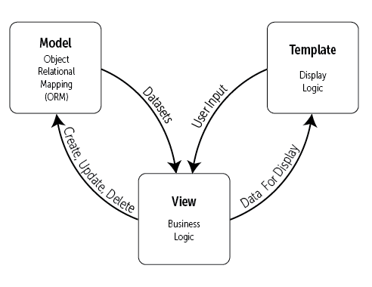
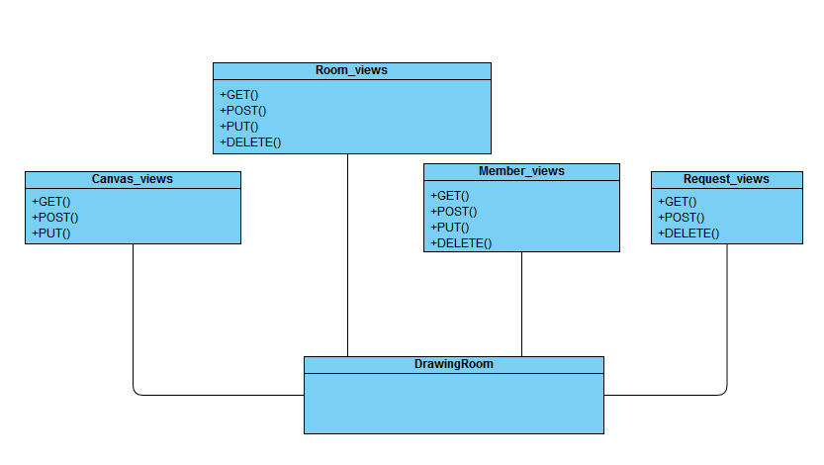
What is your proposed solution?
Give an design overview of the structure of the solution.
Figure 2 .GUI design
Figure 1 . MVT model ( (Figure 3.1 https://djangobook.com/mdj2-django-structure/))

Slide 9
How will you evaluate your solution?
State the evaluation/validation method and how this method has been used before:
Check if the requirements are met for each of the core functionality
Test for efficiency of the solution for example:load time, security,user interface,real time interaction,...
Compare the solution to other existing solutions and further improve different aspects of the project
Define who the stakeholders are and decide if the project's gathered requirements are satisfiable for their needs
Check if the solutions satisfy personal constraints for the project.
Why this method and not another?
As mentioned before in previous slides, there is only a few application that implement the solution for this problem but each of them solve only some parts of the problem
This solution let user chat and painting together in real time, thus provide a simualtion of face-to-face interaction

Slide 10
How will you evaluate your solution?
What are the benefits and risks of this method?
Benefit:
This allows real time interaction between user and user
User can work on painting together with other people at real time while being able to communicate with each other
Can easily decide who join and who is allowed to join in drawing session
Allows for easy member finding and look for people with the same interest in art
Risk:
The application stores personal information of user,which could be exposed if not secured properly
Requires study of new protocol(Web socket) and each month is a dealine for each iteration of the prototype,which need to be followed strictly
Use of different frameworks for front-end and back-end

Slide 11
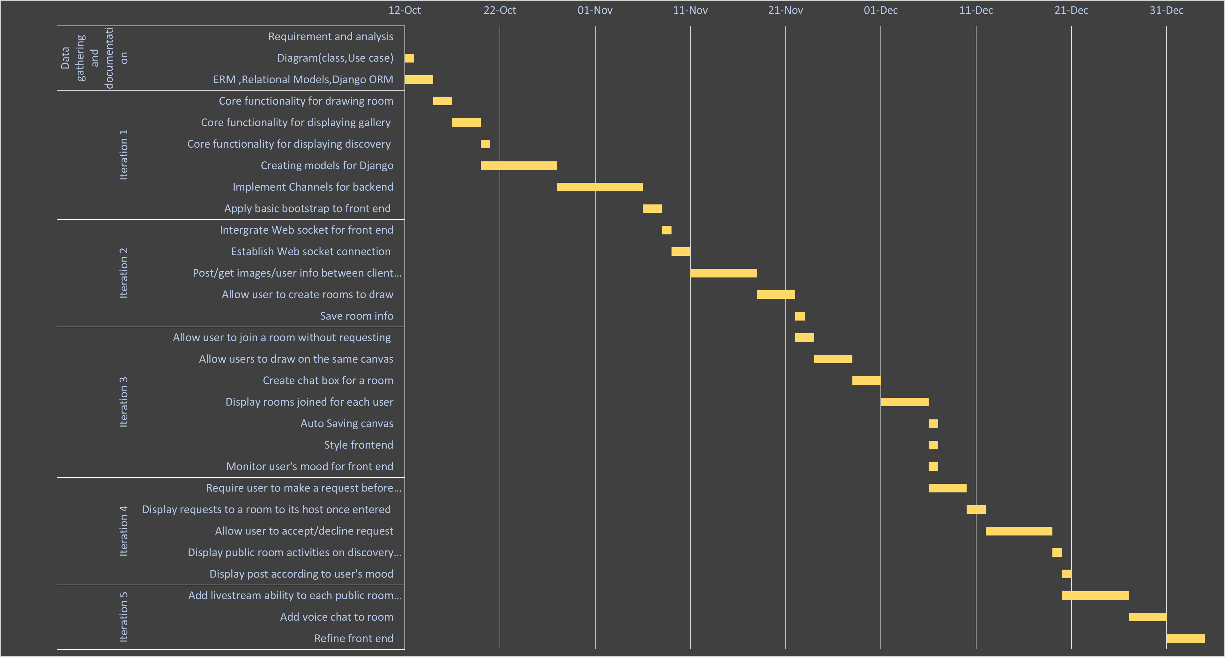
Project Planning
Gantt chart

Slide 12
Risk Register
Implementation risk:Developer experience, Version control
Requirement risk:False collection,requirement change,requirement difficulty
Time Management risk:Planning,Delay
Personal risk:Personal health,working enviroment,other projects
Copyright risk:Plagiarism,User plagiarism

Slide 13
References
1.Tanner Christensen(July 2013) .https://creativesomething.net [Online]
https://creativesomething.net/post/55508909341/the-link-between-depression-and-creativity-and
2.Nuacht UCD(June 2012),www.ucd.ie[Online] https://www.ucd.ie/news/2012/06JUN12/130612-Socialising-helps-to-alleviate-symptoms-of-depression.html
3.NHS[Online]www.nimh.nih.gov
https://www.nimh.nih.gov/health/topics/depression/index.shtml
4.Lindsay Dodgson(July 2018)[Online]
https://www.insider.com/the-link-between-creativity-and-mental-health-2018-7
5.Bulfut(2019) SocializationHelpsTheTreatmentOfDepressionInModernLife
6.rtor.org(July 2018)[Online]
https://www.rtor.org/2018/07/10/benefits-of-art-therapy/

Slide 14
References
7.Concept Art Empire[Online]
https://conceptartempire.com/digital-painting/
8.Adobe.Adobe’s beginer’s guide to digital drawing tools[Online]
https://www.adobe.com/uk/creativecloud/illustration/discover/digital-pens-digital-tools.html
9.Django.Django.com [Online]
https://www.djangoproject.com/start/overview/
10.Kalpit(Aug 2018).When To Use(And When not to).medium.com[Online]
https://medium.com/crowdbotics/when-to-use-django-and-when-not-to-9f62f55f693b
11.developer.mozilla.org[Online]
https://developer.mozilla.org/en-US/docs/Learn/Common_questions/What_is_a_web_server

Slide 15
References
12.Positive Stud(September 2020).What is WSGI(Web Server Gatewat Interface).www.medium.com[Online]
https://medium.com/analytics-vidhya/what-is-wsgi-web-server-gateway-interface-ed2d290449e
13.ASGI(March 2019).ASGI(Asynchronous Server Gateway Interface)[Online]
https://asgi.readthedocs.io/en/latest/specs/main.html
14.Geeksforgeeks(Dec 2019)[Online]
https://www.geeksforgeeks.org/what-is-web-socket-and-how-it-is-different-from-the-http/
15.Ruben Dinis(2018).A simple Real Time Chat with Django Channels and React[Online]
https://revs.runtime-revolution.com/a-simple-real-time-chat-with-django-channels-and-react-b73edc3a79f2
16.Djangobook.Django’s structure-a heretic’s eye view,Figure 3.1[Online]
https://djangobook.com/mdj2-django-structure/

